Slide 1
INFO1111: Computing 1A Professionalism Week 1: Professionalism
“If you think you are worth what you know, you are very wrong. Your knowledge today does not have much value beyond a couple of years. Your value is what you can learn and how easily you can adapt to the changes this profession brings so often.” — Jose M. Aguilar
We’ll start the class at 11:05am
But while you wait…
Go to www.menti.com, enter the code 68 91 50 2, and answer the question.
Professor David Lowe
School of Computer Science

Slide 2
Acknowledgement of Country
I would like to acknowledge the Traditional Owners of Australia and recognise their continuing connection to land, water and culture. I am currently on the land of the Darramurragal people of the Eora Nation and pay my respects to their Elders, past, present and emerging.
I further acknowledge the Traditional Owners of the country on which you are on and pay respects to their Elders, past, present and future.
Notes:
For details of traditional custodians of campuses and facilities visit the intranet page below.
https://intranet.sydney.edu.au/contacts-campuses/campus-information/traditional-custodians-of-the-land.html
For other locations refer to the AIATSIS map of Indigenous Australia
https://aiatsis.gov.au/explore/articles/aiatsis-map-indigenous-australia

Slide 3
Introductions
Coordinator/Lecturer
Prof David Lowe
Teaching Assistants (x2)
Joshua (Josh) Burridge
Lagsiny Kathirgamanaarthan
Tutors (x8)
Dr. Andrea Stern; Anshu Kumar; Daniel Friedrich; Chouthereyi Kathirgamanaarthan; Lagsiny Kathirgamanaarthan; Falguni Sanyal; Josh Burridge; Leonard Davies; Revathi Shinde
Students (~500)
BAdvComp (70%); BAdvComp + BX (30%) + …
Commencing students (65%); Continuing students (35%)

Slide 4
Getting to know each other
A network of people you know is vital for information, support and well being.
In previous semesters…
Activity
Turn to the person behind you and ask each other the following questions….
But online, with 500 students, that is somewhat more difficult – so we’ll be working on this in the tutorials…
In the meantime: we’ll use mentimeter to get you thinking about computing jobs…
Activity
Go to www.menti.com
Q: What 3 aspects of IT/Computing most interest you?

Slide 5
IT Careers – What do they look like?
Which key words in the previous exercise describe professional IT careers? How do you know?
Activity
Select a job website (for example http://www.seek.com.au/, https://jobsearch.gov.au/, https://www.careerone.com.au/ etc.) and search for key words.
Go to www.menti.com
Q: Brief description of an industry role (<5 words)
Key word(s) | Roles
IT Programming Java | Java Developer Full Stack Java Developer IT support officer IT Graduate Position
Specialist Database | Microsoft SQL/DBA Consultant Business Systems and Database Administrator B2B Client Services Database Technical specialist

Slide 6

Word cloud for “Information Technology Software Programming Computing” search on Seek.

Slide 7
IT Careers – What do they look like?
experience 32
software 31
knowledge 26
skills 25
client 21
applications 18
technical 17
team 17
development 17
design 17
solutions 16
understanding 15
business 14
crm 14
role 14
systems 13
management 12
programming 12
customer 12
services 12
ability 11
work 11
years 11
data 10
support 10
industry 9
computing 9
customers 9
developer 8
opportunity 8
awareness 8
engineer 8
level 8
application 7
platform 7
highly 7
requirements 7
java 7
integration 7
delivery 6
staff 6
maintain 5
cloud 5
functional 5
problems 5

Slide 8
How have careers changed? Then and now…
In 2000… (that are disappearing in 2021)
User Interface Designer
Flash Developer
Fortran programmer
Software Support
SEO Specialist
Quality Assurance Manager
Windows XP Admin
Voice Telephony
C/C++, VB, Perl, …
(* see http://readwrite.com/2013/05/01/10-technology-skills-no-longer-in-demand)
In 2021 (that didn’t exist in 2000*)
User Experience Designer
App Developer
Cloud Developer
Social Media Manager
Data Miner
Chief Listening Officer
Millennial Expert
Internet of Things
Java, Python, PHP, Ruby
(* Or at least were nowhere near as common)

Slide 9
So what skills will we need?
Activity
Consider what skills you will need to develop to get to get one of the jobs advertised and reach your 5 year plan.
Now, what if …
Role | Skills needed
Java Developer | Javascript/ CSS/ HTML5
 | Java E2E
 | Hibernate
 | RESTful services
 | SCRUM/ Agile
 | Eclipse, JIRA, GitHub
 | English
 | Bachelor of Computer Science
 | 2 years experience
Notes:
Examples: Technical skills in multiple languages, skills with multiple tools, team management processes, etc etc. All in 2 years. This isn’t taught at uni – you will have to develop these skills.

Slide 10
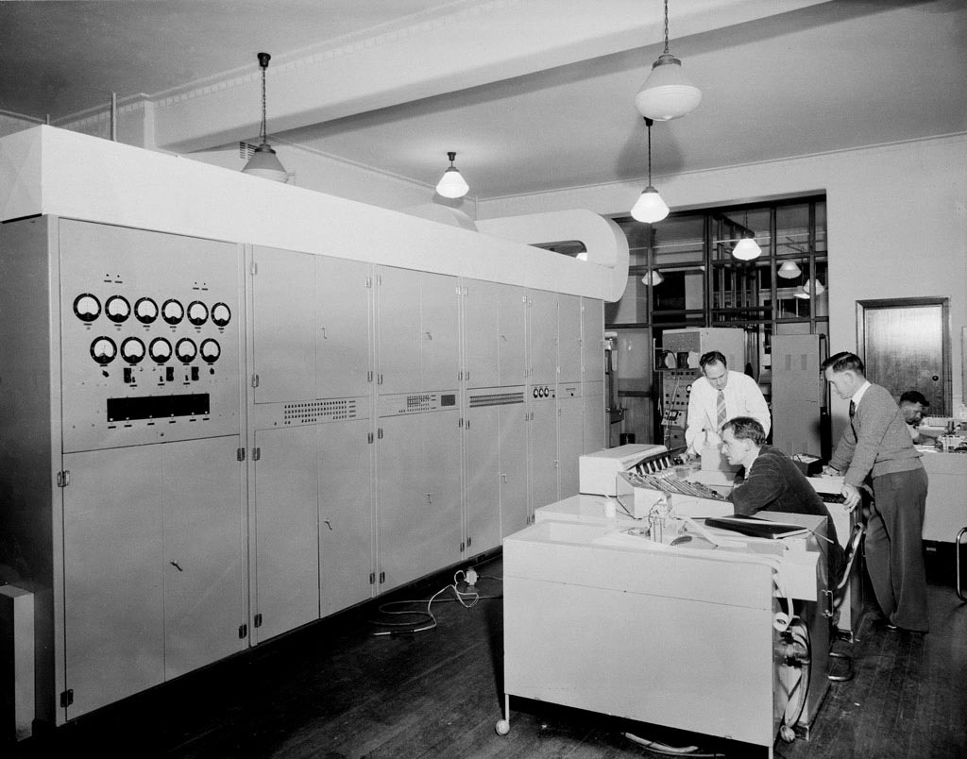


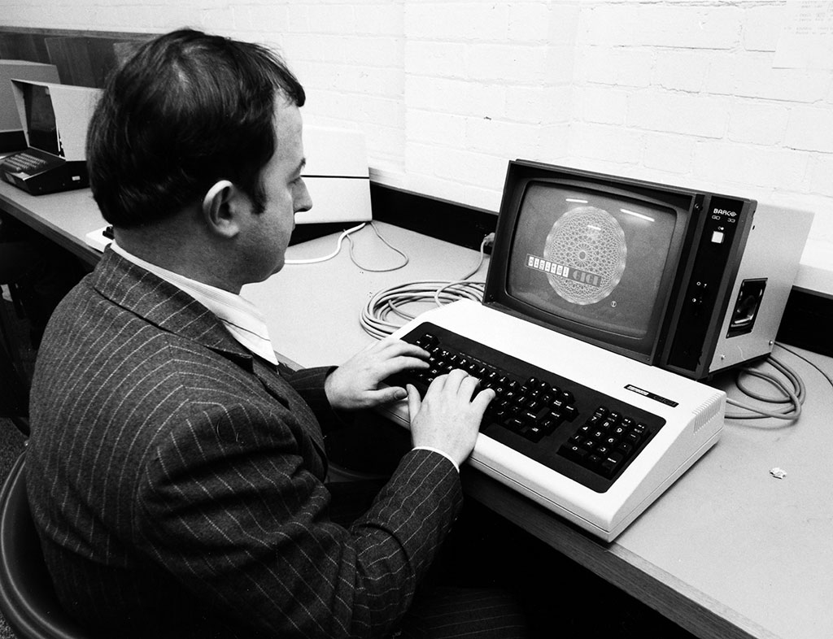
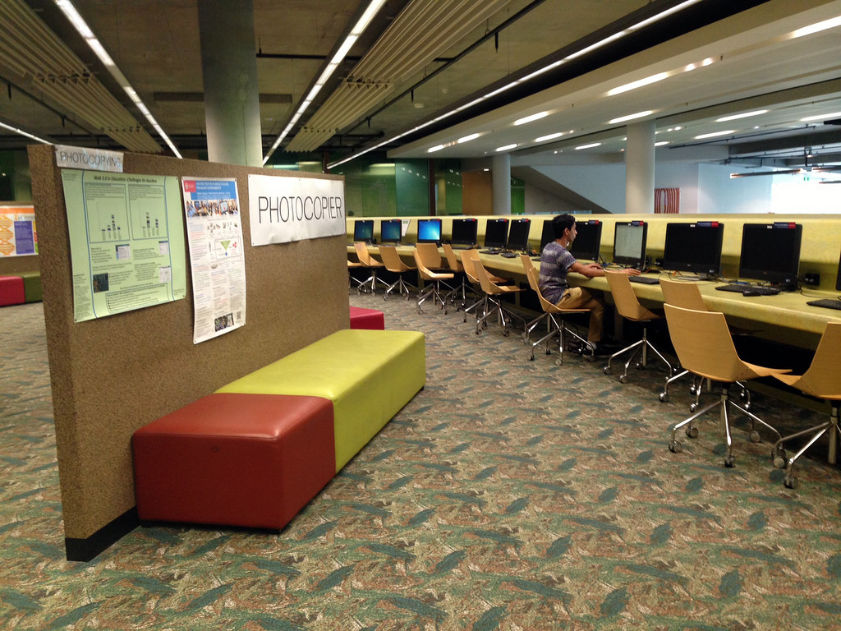
Technology changes quickly.
Guess the year…
BitTorrent
Facebook
YouTube
Google Maps
Twitter
Netflix streaming
iPhone
4G networks
First Android phone
BitCoin
iPad
Raspberry Pi
Apple pay
Apple watch
- 2001
- 2004
- 2005
- 2005
- 2006
- 2007
- 2007
- 2008
- 2008
- 2009
- 2010
- 2012
- 2014
- 2015

Slide 11
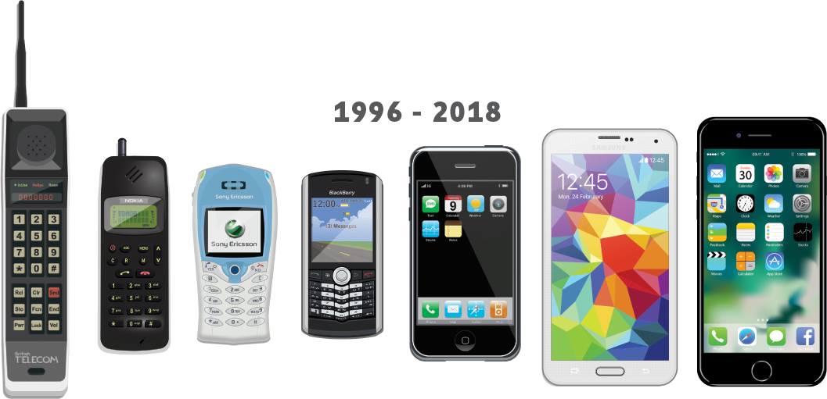
Technology changes quickly.
From: https://www.gadgetguard.com/alara-technology

Slide 12
Technology changes quickly
But we rarely can predict how…
"This 'telephone' has too many shortcomings to be seriously considered as a means of communication. The device is inherently of no value to us.“
Western Union internal memo, 1876.
"I think there is a world market for maybe five computers."
Thomas Watson, 1943 (chairman of IBM)
“Computers in the future may weigh only 1.5 tons.”
Popular Mechanics, 1949
“There is no reason anyone would want a computer in their home.”
Ken Olsen, 1977
“We will never make a 32-bit operating system.”
Bill Gates, 1989
“I believe OS/2 is destined to be the most important operating system, and possibly program, of all time.”
Bill Gates, 1987
“Spam will be a thing of the past in two years’ time.”
Bill Gates, 2004
“Next Christmas the iPod will be dead, finished, gone, kaput.”
Sir Alan Sugar, 2005 (founder of Amstrad)
See http://www.rinkworks.com/said/predictions.shtml for many more...

Slide 13

Technology in 15 years time
Activity
Go to www.menti.com
Q: What technology will be common in 15 years that does not exist now?

Slide 14
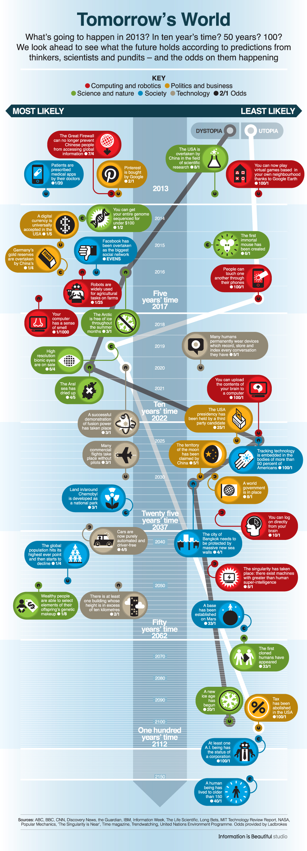
Technology in 15 years time
See http://www.bbc.com/future/story/20130102-tomorrows-world

Slide 15
Technology in 15 years time
What did you predict?
Typically we over-estimate short-term impacts and under-estimate mid-long term impacts…
Others predictions…
Quantum computing; metaOS; Zero-size computing; neurohacking; mass data; nanotech (nanomed, genetech, …); cyber-security and dark networks; babel fish; surrogates; augmentation; … ; the singularity (read Ray Kurzweil)
https://www.weforum.org/agenda/2020/06/17-predictions-for-our-world-in-2025/
https://www.pewresearch.org/internet/2020/06/30/innovations-these-experts-predict-by-2030/
https://rossdawsonblog.com/trends_and_technology_timeline_2010.pdf
https://www.arup.com/perspectives/publications/research/section/emerging-technology-timeline
https://electronics.howstuffworks.com/future-tech/10-futurist-predictions-in-the-world-of-technology.htm
https://www.futuretimeline.net/
And maybe:
https://maryjomarieburke.files.wordpress.com/2012/10/fiction-infographic1.jpg
http://www.futuretimeline.net/forum/topic/8070-charts-graphs-and-statistics-of-the-future/page-4
http://www.visualcapitalist.com/timeline-future-technology/

Slide 16

And if you stop learning…
If you graduate, then don't learn anything more, what will happen to you?
“[anyone] not busy being born is busy dying”, Bob Dylan
Conclusion:
We will teach you core skills, but…
Important for your future careers, that you can grow and develop...
This is more important in IT than almost any other area!

Slide 17
So – this unit
What does it mean to work in computing?
What are the different pathways?
What skills will you need to succeed?
What can go wrong?
https://www.youtube.com/watch?v=gp_D8r-2hwk

Slide 18
Break…
And after the break…
The boring (but important) admin bits….
Take 10 mins to stretch your legs, get a drink, …

Slide 19
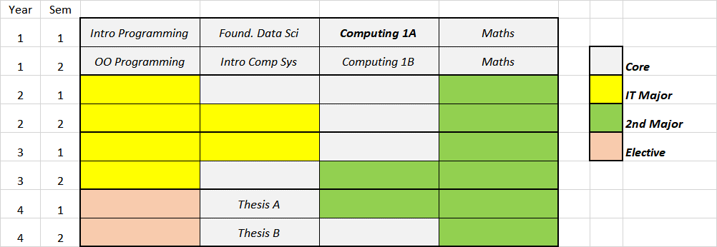
The admin bits… Your Degree
Bachelor of Advanced Computing: key requirements = 192cp made up of…
96cp Core…
48cp IT Major (Table A)
12cp 4000-level electives
optional 12cp of OLE units)
optional 36cp or 48cp second major (Table A or S)
Additional IT electives to bring the total to 192cp
But how does this fit ???
Key sources
Degree Resolutions:
https://www.sydney.edu.au/handbooks/engineering/advanced_computing/advanced_computing_rules.shtml

Slide 20
Combinations of majors
each student does one major on computing; can then do a second major (more computing), a second major (something different, from shared pool) or a self-chosen selection of electives.
Software Development Major
+
Music Major
To revolutionise sound production
To help fight antibiotic-resistant viruses
To make real-time translation a reality
To help reshape the way in which business respond to customers needs
To produce software systems that deliver most value in their enterprise context
→
Information Systems Major
+
Marketing Major
→
Computer Science Major
+
Linguistics Major
→
Computational Data Science Major
+
Genetics & Genomics Major
→
Information Systems Major
+
Software Development Major
→

Slide 21
The Admin Bits…. UoS Overview
Topics covered
Professionalism
Teamwork
Tools
Pathways (Majors and career options)
(See https://www.pluralsight.com/blog/career/cs-and-is-students-need-to-know-by-graduation)
Learning outcomes
https://www.sydney.edu.au/units/INFO1111
Resources
Canvas - login using Unikey and password
Lecture content and copies of lecture slides
Lecture videos
We intend to record the lectures (but the technology is not reliable – and we still want you to listen live)
Tutorial instructions
Assignment instructions
Submit activities and official assignment work here
see your grades; etc
Canvas/Unit Outline for official schedule, list of learning outcomes, etc
Discussion forum - Ed: on Canvas site

Slide 22
More admin
Lecture: Thursday 11am to 1pm, on zoom
Tutorial session: depends on your timetable:
Thursday or Friday; Online or F2F
It is important you attend these, as there is groupwork…
Expectations: You are responsible learners!
Attend scheduled classes, and devote an extra 6-9 hrs per week
Participate in classes, constructively
Respect for one another (criticize ideas, not people)
Humility: none of us knows it all; each of us knows valuable things
Check Canvas site regularly - at least once a week!
Notify academics whenever there are difficulties
Notify group partners honestly and promptly about difficulties

Slide 23
Assessments
Overview:
Your final grade in INFO1111 is based on Levels you achieve in the core learning Areas, instead of adding different % weighted assessments
So, how does it work…
There are three core learning areas:
Knowledge; Practice; Self-eval and learning
And in each area you can progress through levels:
0=unsatisfactory
1=Satisfactory
2=Advanced
3=Expert
4=Outstanding
And then your final result depends on the levels you reach:
Mark | Minimum Requirement
0F | Level 0 in all areas
20F | + one level 1
40F | + two level 1
50P | Level 1 in all three areas
55P | + one level 2
60P | + two level 2
65C | Level 2 in all three areas
70C | + one level 3
75D | + two level 3
80D | Level 3 in all areas
85H | + one level 4
90H | + two level 4
95H | Level 4 in all areas
100H | + Outstanding performance in the oral examination, project 2B and self-learning.

Slide 24
Assessments - Levels
Level 1
Satisfactory
Demonstrated the core required content and skills to the level required to move on to subsequent units
Level 2
Advanced
Expert
Level 4
Outstanding
Level 3
Succeeded at Level 1 requirements
Demonstrated similar knowledge and skills to Level 1, but to a significant degree of mastery
Succeeded at Level 2 requirements
Demonstrated knowledge and skills beyond the core requirements
Succeeded at Level 3 requirements
Demonstrated exceptional knowledge and skills beyond the core requirements

Slide 25
Assessments - Areas
Knowledge
Level 1: Midsemester Exam, or Online Basic Quiz
Level 2: Online Advanced Quiz
Practice
Level 1:Project 1 or Project 2A
Level 2: Project 2A or Project 2B
Self-Review Self-Learning
Level 1: Basic Self Learning Report
Level 2: Advanced Self Learning Report
Level 3: End of Semester Written Exam
Level 4: End of Semester Oral Exam
Level 3: Project 2A or Project 2B
Level 4: Project 2B
Level 3: Advanced Report + Demonstration
Level 4: Advanced Report + Advanced Demo

Slide 26
Assessments - Activities
Knowledge
Midsemester Exam Can award Level 1 Mandatory
Online Basic Quiz Can award Level 1 Mandatory for students who do not achieve Level 1 in the Midsemester Exam
Practice
Project 1 (Group) Can award Level 1 Mandatory
Project 2A (Individual) Can award Level 1, 2, or 3 Mandatory for students who do not achieve Level 1 in Project 1. Optional for others.
Self-Review Self-Learning
Self-Assessment & Development Plan Awards no levels on its own, but guides the Report and Demonstration Mandatory
Self-Learning Report Can award Level 1 or 2 Mandatory
End of Semester Written Exam Can award Level 3 Optional. Must achieve Level 2 first
End of Semester Oral Exam Can award Level 4 Optional. Must achieve level 3 first
Project 2B (Group) Can award Level 1, 2, 3 or 4 Optional. Level 1 in Project 1 is required to participate
Online Advanced Quiz Can award Level 2 Optional. Must achieve Level 1 first
Self-Learning Demonstration Can award Level 3 or 4 Optional. Must achieve level 2 first.

Slide 27
Assessments – Final Result
Mark | Minimum Requirement
0F | Level 0 in all areas
20F | + one level 1
40F | + two level 1
50P | Level 1 in all three areas
55P | + one level 2
60P | + two level 2
65C | Level 2 in all three areas
70C | + one level 3
75D | + two level 3
80D | Level 3 in all areas
85H | + one level 4
90H | + two level 4
95H | Level 4 in all areas
100H | + Outstanding performance in the oral examination, project 2B and self-learning.

Slide 28
Assessment – Final Result
Some examples – for final Levels in Knowledge, Practice, and Self-Review & Learning
K: 2, P: 2, SRL: 1 – grade is 60 or Pass
K: 4, P: 3, SRL: 3 – grade is 85 or High Distinction
K: 4, P: 0, SRL: 4 – grade is 40 or Fail
What does this mean? In order to achieve a good result, you need to balance your work.
Start with meeting the Level 1 requirements in all 3 areas first
Notice that there are several optional pieces of assessment – you will need to decide what level of achievement you are willing to work towards, as higher levels will require more time and effort

Slide 29

Late assessments
This is tricky! (Normally late penalties are applied as a proportion of the marks awarded).
So – there are no late penalties.
Some assessment tasks are scheduled at a particular time
e.g. mid-semester exam
If you miss these (and have a valid reason) then you will need to apply for special consideration and alternative arrangements will be made.
Other assessment tasks can be undertaken at any time.
e.g. the advanced knowledge quiz
For all other assessment tasks:
E.g. project reports, self-assessment plan, and self-learning report:
They have a recommended due date. They can be submitted after that date, but…
Each will have "timeliness" as one of the assessment criteria, and so a submission after the due data will be taken into account in assessing the level awarded.
And in some cases a late submission may also affect subsequent options.
E.g. a late submission of the self-learning tasks may affect whether you can book a demonstration timeslot (e.g. required for levels 3 and 4 of the self-learning task).

Slide 30
Special Consideration (University policy)
If your performance on assessments is affected by illness or misadventure:
Follow proper administrative procedures
Have professional practitioner sign special USyd form
Submit application for special consideration online, upload scans
Note you have only a quite short deadline for applying
http://sydney.edu.au/current_students/special_consideration/
Also, notify coordinator by email as soon as anything begins to go wrong
There is a similar process if you need special arrangements eg for religious observance, military service, representative sports

Slide 31
Academic Integrity (University policy)
“The University of Sydney is unequivocally opposed to, and intolerant of, plagiarism and academic dishonesty.
Academic dishonesty means seeking to obtain or obtaining academic advantage for oneself or for others (including in the assessment or publication of work) by dishonest or unfair means.
Plagiarism means presenting another person’s work as one’s own work by presenting, copying or reproducing it without appropriate acknowledgement of the source.” [from site below]
http://sydney.edu.au/elearning/student/EI/index.shtml
Submitted work is compared against other work (from students, the internet, etc)
TurnitIn for textual tasks (through Canvas), other systems for code
Penalties for academic dishonesty or plagiarism can be severe
Complete self-education AHEM1001 (required to pass INFO1111)

Slide 32
Emergency procedures (for those on campus)
In the unlikely event of an emergency we may need to evacuate the building.
If we need to evacuate, we will ask you to take your belongings and follow the green exit signs .
We will move a safe distance from the building and maintain physical distancing whilst waiting until the emergency is over.
In some circumstances, we might be asked to remain inside the building for our own safety. We call this a lockdown or shelter-in-place.
Further information is available at www.sydney.edu.au/emergency
Notes:
Due to physical distancing requirements building occupants are not gathering at the usual assembly area when evacuating. The advice is to disperse rather than assemble but you should keep your class together (with physical distancing) if you intend to return to class once the emergency is over. If you intend to end the class, you can let the students disperse.

Slide 33
Keeping our community safe
We can all help reduce the spread of COVID-19 through following good hygiene practices:
Wash hands regularly, for at least 20 seconds with soap and water, or use an alcohol-based hand rub.
Cover your mouth when coughing and sneezing with a tissue or a flexed elbow.
Maintain a distance of at least 1.5m between yourself and others, where possible.
Avoid large gatherings, where possible.
Avoid close contact with anyone with cold or flu symptoms, e.g. fever, cough, runny nose or shortness of breath.
Notes:
Remind students to follow guidelines for health management when coming to campus, to protect the health of our students and staff.
Following good hygiene practices on or off campus will also help protect the broader community.

Slide 34
Keeping our community safe
All students and staff who have cold or flu symptoms should isolate themselves from others.
If you are unwell with cold or flu symptoms please excuse yourself from this class and we will support you to continue the work remotely.
Make sure you read the information on special consideration in the unit outline.
Notes:
As a precaution, and generally as good practice, we are asking all students and staff who have cold or flu symptoms to isolate themselves from others and get tested for COVID-19.
If you are have these symptoms, please excuse yourself from this class (even if you are wearing a surgical mask) and we will support you to continue the work remotely or bring you up to speed asap.
Make sure you read the information on special consideration in the unit outline.

Slide 35
Keeping our community safe
The University is following advice from the government and related public health authorities.
For the latest information, see the advice on the University website.
In some classes, especially those involving use of shared equipment, please follow additional advice from your coordinators.
Please take care of each other and yourselves and if you need support reach out to your unit coordinator or the health and wellbeing area of the Current Students website.
Notes:
Provide students with additional details for unit of study as applicable.

Slide 36
Tips for students joining online
Remember that you are still in a space with other students.
Mute your microphone when not speaking.
Use earphones or headphones - the mic is better and you'll disturb others less.
If you have a webcam, please switch it on so we can see you!
If you are speaking to the camera, make eye contact with the camera (and therefore your classmates and teacher).
Try not to talk over someone else.
Use the chat function to send messages to the teacher or classmates during class.
Notes:
For those of you haven’t taken part in online classes before, here are a few tips to help make it a great experience and ways to communicate with each other during the class.

Slide 37
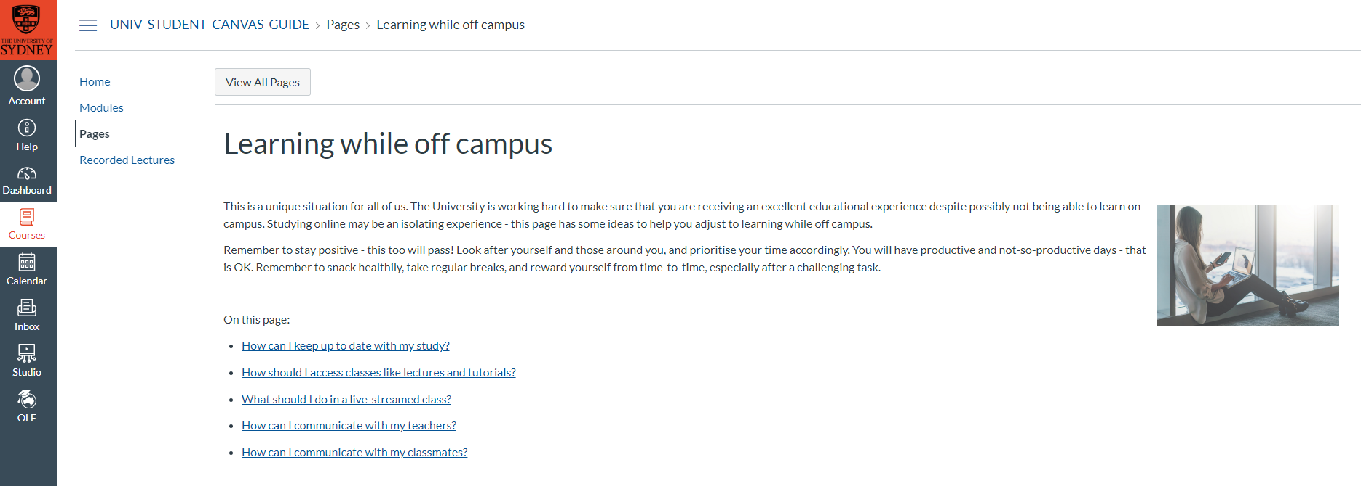
Tips for students learning online
For tips and guides on learning online and the tools you will use, refer to Learning while off campus resources in Canvas.
Notes:
Visit Canvas to access resources to support your online learning experience.

Slide 38
This Week’s Tutorial
Meet your tutors
And answer any questions about things discussed today…
Group project
Form groups for Project 1
Self-learning
Begin your self-assessment
Planning for self-learning
Initial self-learning activity

Slide 39
Group Project
Groups of 4
Scenario
The four members of your group have all recently graduated and been employed by an IT consulting company. This company has many consulting contracts, but there are four consulting projects, each of which needs one more person – and these roles are in the four main areas of computing: CS, SD, IS, DS.
Your group must provide a recommendation as to which of you will be assigned to each of the four consulting projects.
Requirements
A skills analysis of the four members of your team
An analysis of the skills required to work in each of the four areas of computing (i.e. the four majors in your degree)
An analysis and recommendation regarding your allocation

Slide 40
Self-Learning
How good are you at learning independently?
Can you identify something you learnt yourself, without it being directed by someone else?
How did you manage this?
Initial Activity
We want you to learn “MarkDown”
a document formatting ‘language’ widely used for online documents
But you should only spend 2-3 hours
See how far you can get prior to next weeks class…
Not assessed – so no point in copying off others!

Slide 41
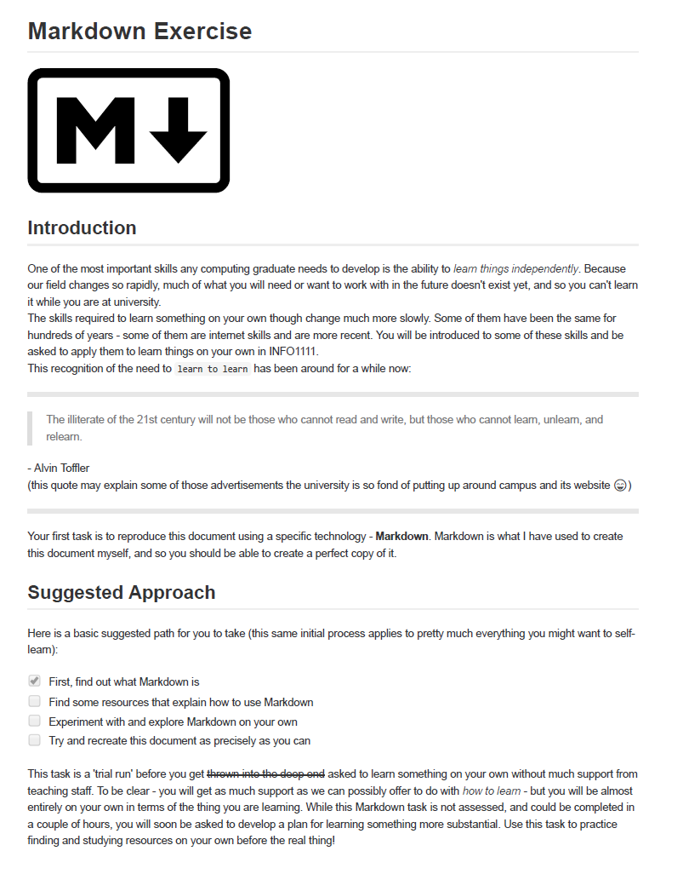
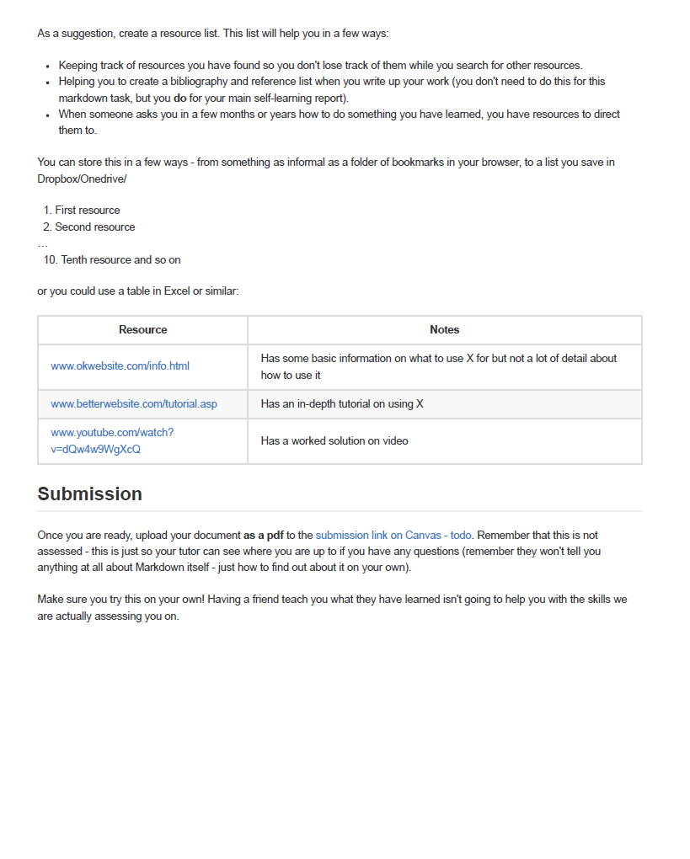
Self Learning

Slide 42
Questions?

Slide 43
Academic Integrity Practice
School of Computer Science

Slide 44
Different levels/types of Academic Integrity practice
Source:
Different types of sources of help are accepted for different academic levels (Junior, Intermediate, Senior, Postgraduate)
Nature of Help:
Different types of help are accepted for different types of assessment.
Two slides explaining “Source” and “Nature” of help allowed
You can adjust the chart to suite the academic integrity requirement for your assessments.

Slide 45
Example 1: Junior level programming UoS
Source of Help
Lecturer | Teaching Assistants / Tutors | Classmates | Private tutors | Online forums/ Online tutors | Students outside course/UoS | Hired coders Tutorial Company outside University | Relatives | Other
Individual assessment
A student needs to gain an understanding of fundamental knowledge/skills
It is important to master the knowledge/skills themselves
Encouraged
Attribution required
Not acceptable
Ask Lecturer/Coordinator

Slide 46
Example 1: Junior level programming UoS
Types of Help
Understanding General Concepts | Explained using similar material (not assignment) | Sharing approach/concept to derive assignment solution | Designing code/solution | Implementing code/solution
Individual assessment
A student needs to gain an understanding of fundamental knowledge/skills
It is important to master the knowledge/skills themselves
Students are encouraged to obtain help through relevant teaching materials and practices but not directly on assessment materials
Encouraged
Attribution required
Not acceptable
Ask Lecturer/Coordinator

Slide 47
Example 2: Intermediate/Senior level specialist UoS
Source of Help
Lecturer | Teaching Assistants / Tutors | Classmates | Private tutors | Online forums/ Online tutors | Students outside course/UoS | Hired coders Tutorial Company outside University | Relatives | Other
Individual assessment
A student needs to gain an understanding of high level knowledge/skills
A student needs to gain skills to find, evaluate and apply existing knowledge/solutions
Encouraged
Attribution required
Not acceptable
Ask Lecturer/Coordinator

Slide 48
Example 2: Intermediate/Senior level specialist UoS
Types of Help
Understanding General Concepts | Explained using similar material (not assignment) | Sharing approach/concept to derive assignment solution | Designing code/solution | Implementing code/solution
Individual assessment
A student needs to gain an understanding of fundamental knowledge/skills
It is important to master the knowledge/skills themselves
Students are encouraged to obtain help through relevant teaching materials and practices
Encouraged
Attribution required
Not acceptable
Ask Lecturer/Coordinator

Slide 49
WHS Induction
School of Computer Science

Slide 50





General Housekeeping – Use of Labs
Keep work area clean and orderly
Remove trip hazards around desk area
No food and drink near machines
No smoking permitted within University buildings
Do not unplug or move equipment without permission

Slide 51
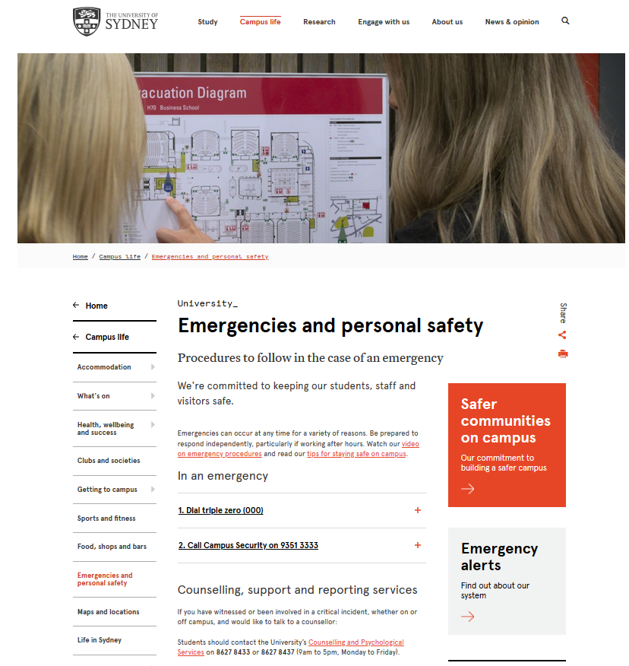
EMERGENCIES – Be prepared
https://sydney.edu.au/campus-life/safety-security.html

Slide 52
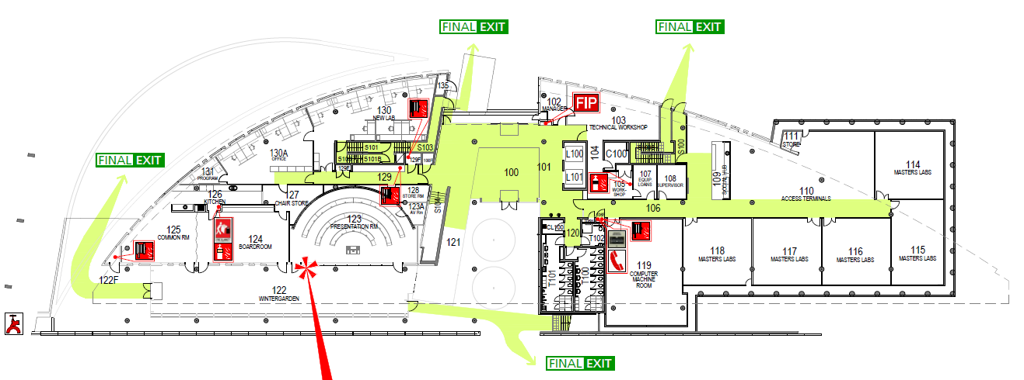
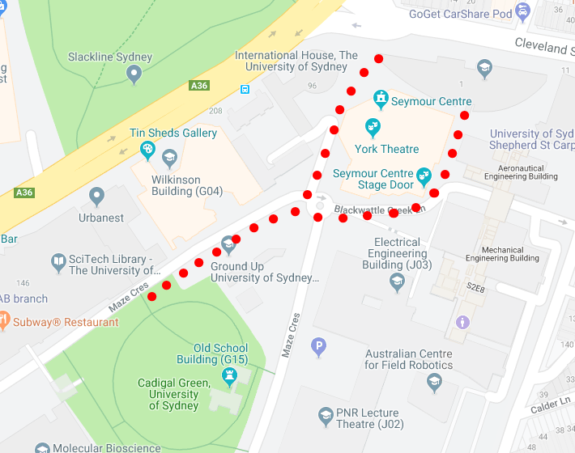
EMERGENCIES
Where is your closest safe exit ?
Assembly Area: Cadigal Green

Slide 53
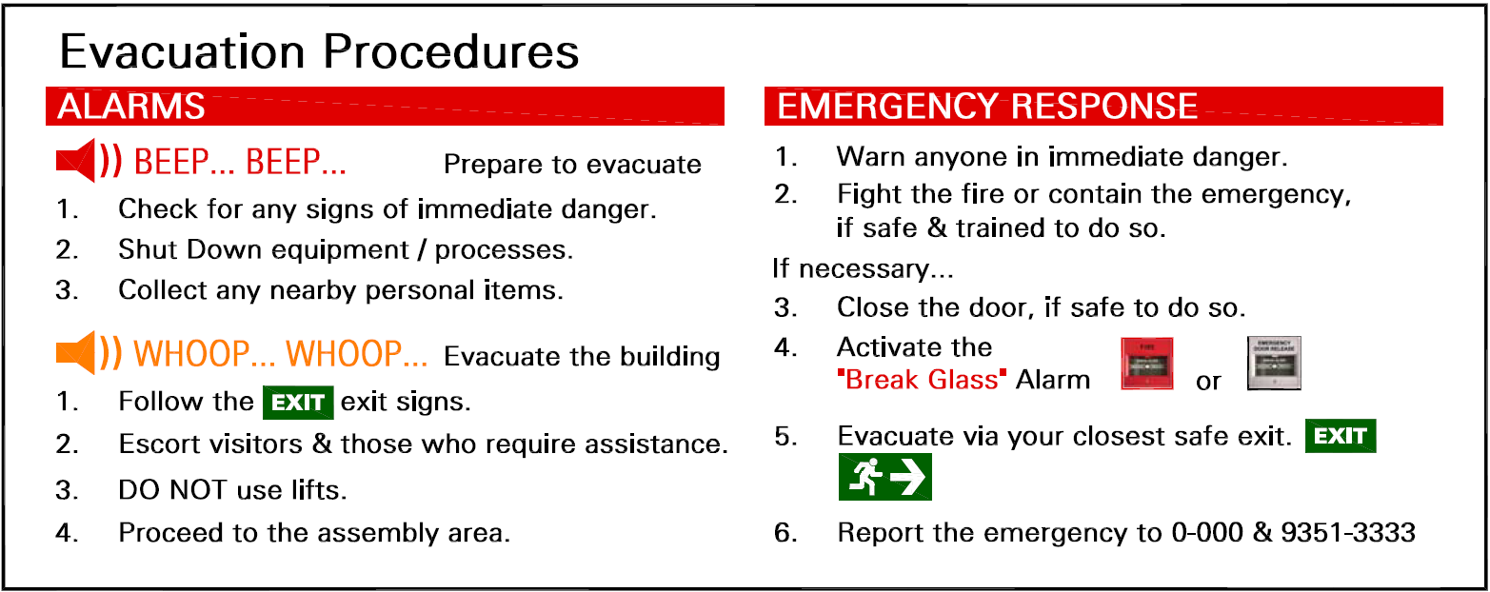
EMERGENCIES

Slide 54


MEDICAL EMERGENCY
l
If a person is seriously ill/injured:
call an ambulance 0-000
notify the closest Nominated First Aid Officer
If unconscious– send for Automated External Defibrillator (AED) AED locations.
NEAREST to CS Building (J12)
- Electrical Engineering Building, L2 (ground) near lifts
- Seymour Centre, left of box office
- Carried by all Security Patrol vehicles
call Security - 9351-3333
Facilitate the arrival of Ambulance Staff (via Security)
Nearest Medical Facility
University Health Service in Level 3, Wentworth Building
First Aid kit – SIT Building (J12)
kitchen area adjacent to Lab 110

Slide 55

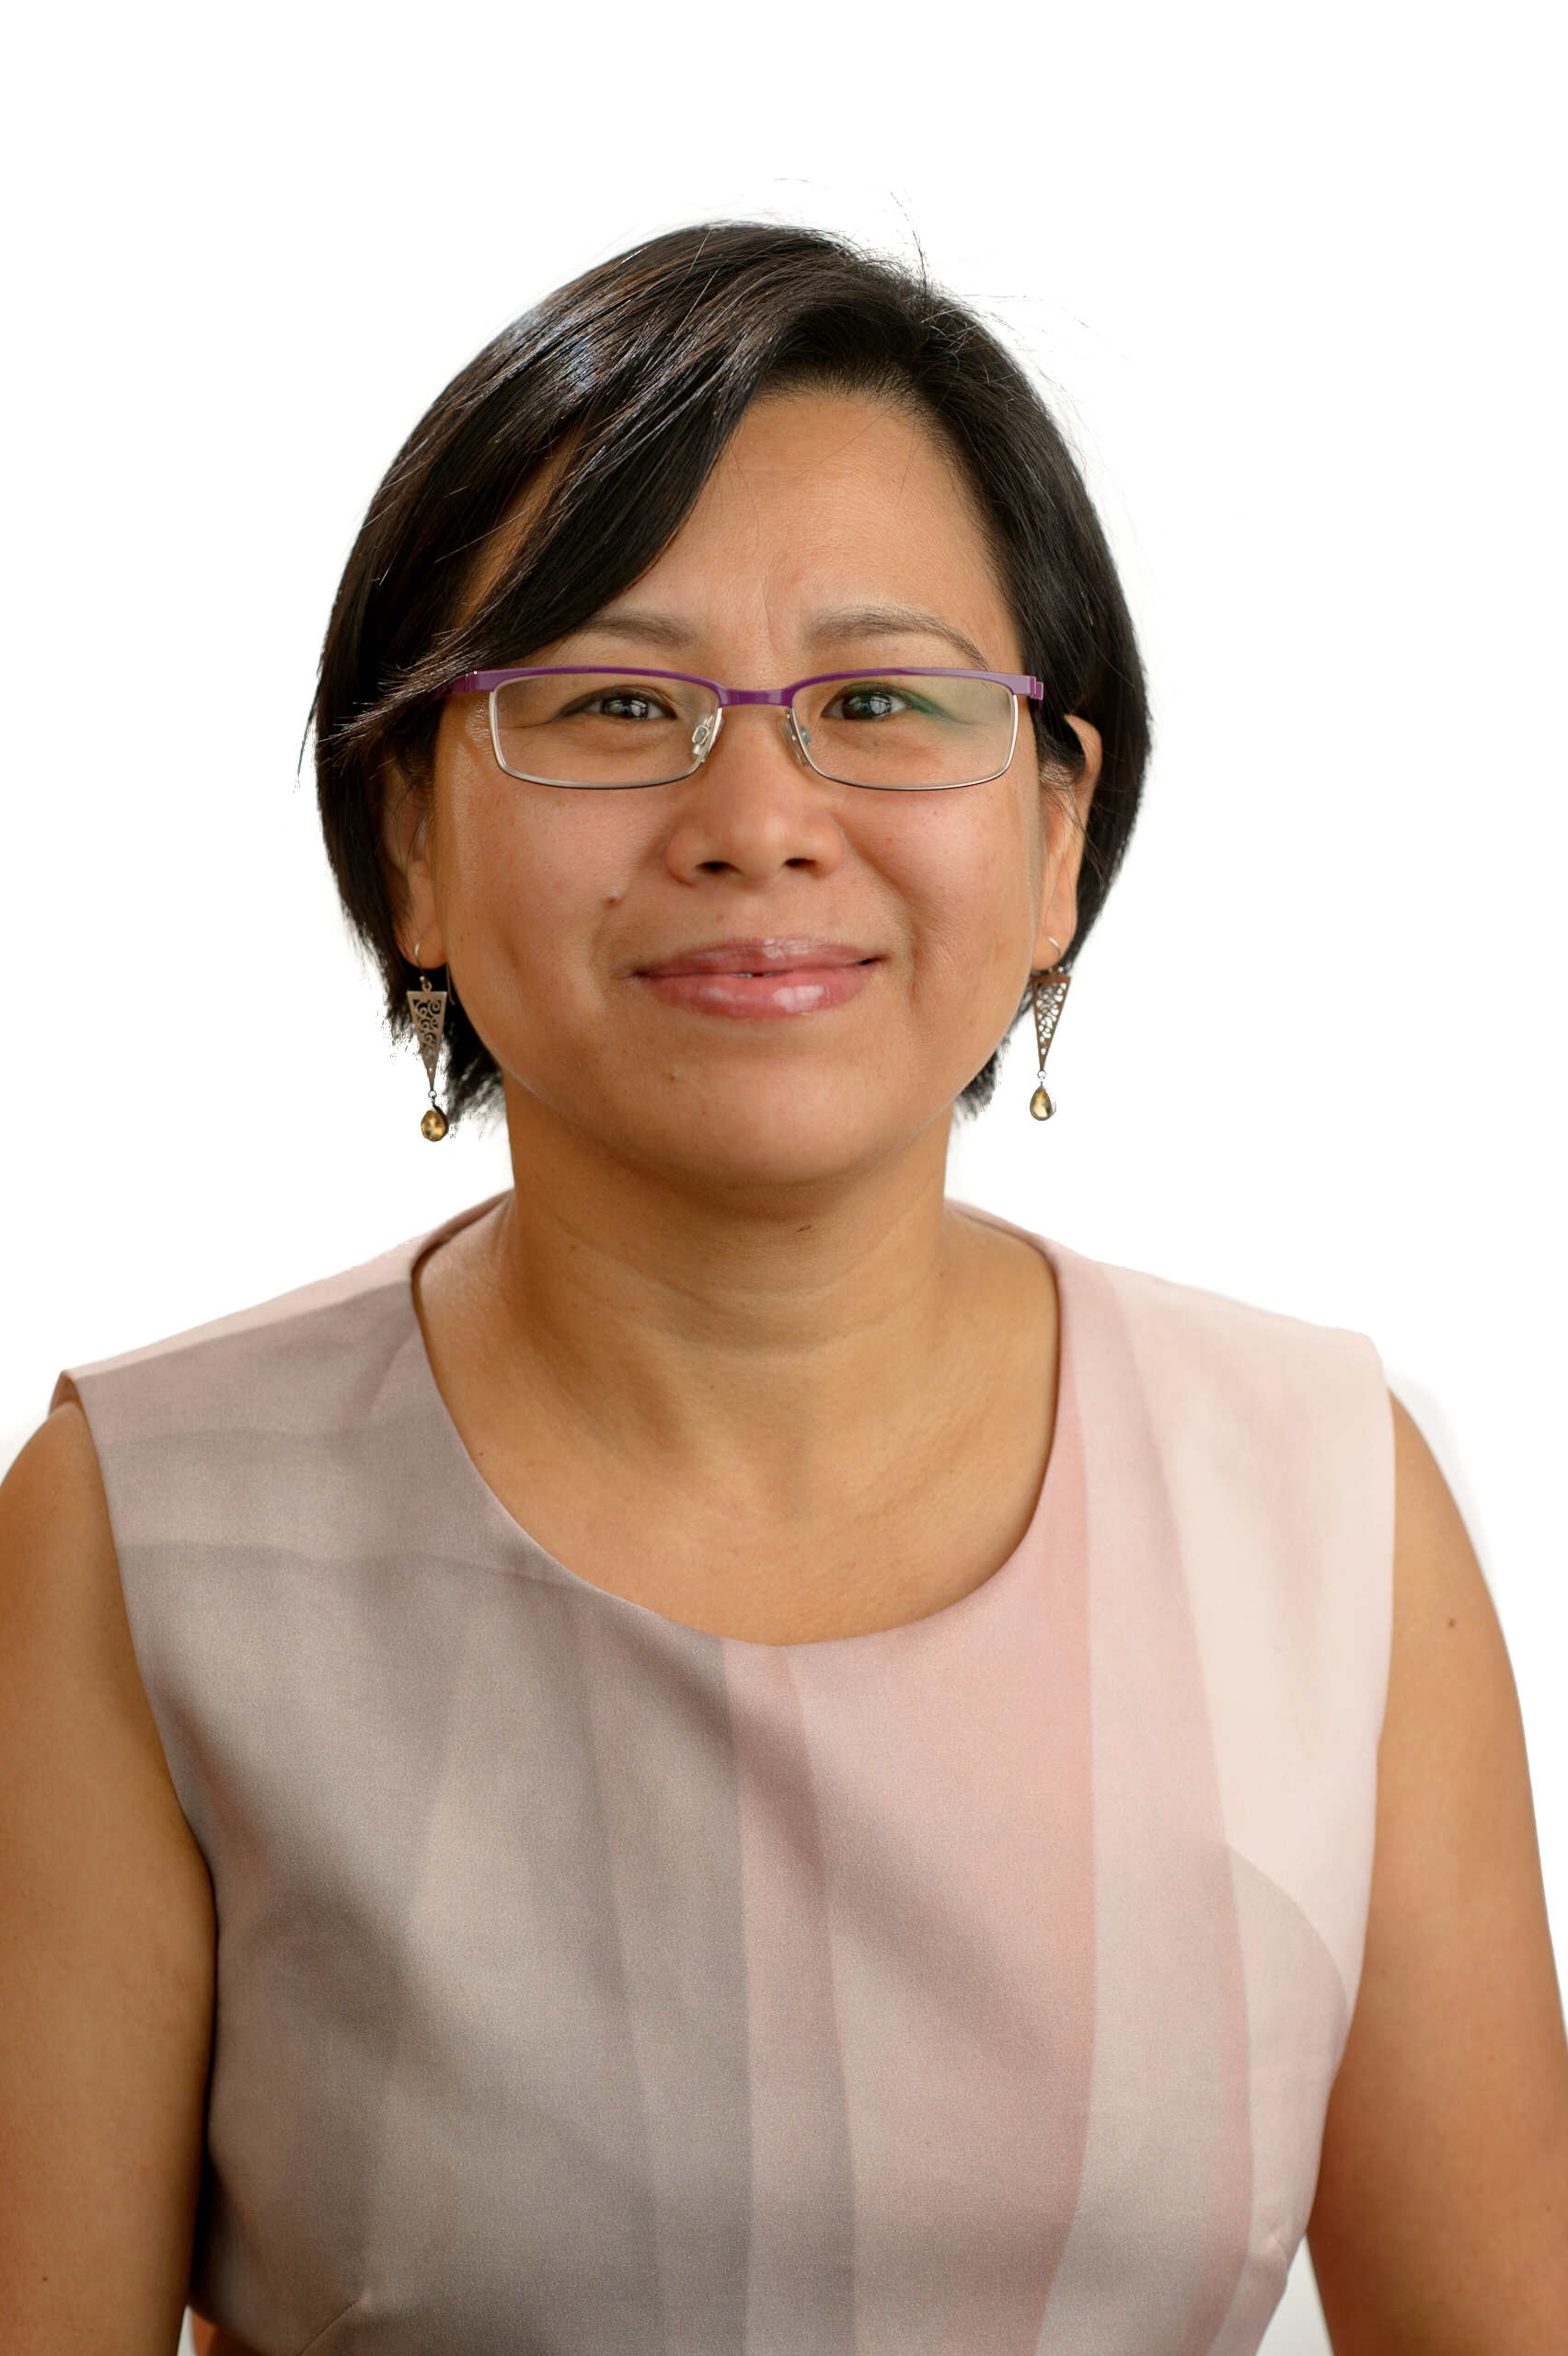

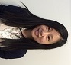
School of Computer Science Safety Contacts
CHIEF WARDEN Greg Ryan
Level 1W 103
9351 4360
0411 406 322
Orally REPORT all
INCIDENTS
& HAZARDS
to your SUPERVISOR
FIRST AID OFFICERS
OR
Julia Ashworth
Level 2E Reception
9351 3423
Undergraduates: to Katie Yang
9351 4918
Coursework
Postgraduates: to Cecille Faraizi
9351 6060
or Keiko Narushima
8627 0872
CS School
Manager: Priyanka Magotra
8627 4295
Will Calleja
Level 1W 103
9036 9706
0422 001 964
Katie Yang
Level 2E 237
9351 4918

Slide 56
Assistance
There are a wide range of support services available for students: https://sydney.edu.au/campus-life/health-wellbeing-success.html
Please make contact, and get help
You are not required to tell anyone else about this
If you are willing to inform the unit coordinator, they may be able to work with other support to reduce the impact on this unit
eg provide advice on which tasks are most significant

Slide 57
DISABILITY SERVICES
Do you have a disability?
You may not think of yourself as having a ‘disability’ but the definition under the Disability Discrimination Act is broad and includes temporary or chronic medical conditions, physical or sensory disabilities, psychological conditions and learning disabilities.
The types of disabilities we see include:
anxiety, arthritis, asthma, asperger's disorder, ADHD, bipolar disorder, broken bones, cancer, cerebral palsy, chronic fatigue syndrome, crohn’s disease, cystic fibrosis, depression, diabetes, dyslexia, epilepsy, hearing impairment, learning disability, mobility impairment, multiple sclerosis, post traumatic stress, schizophrenia , vision impairment, and much more.
Students needing assistance must register with Disability Services –
it is advisable to do this as early as possible.
http://sydney.edu.au/study/academic-support/disability-support.html

Slide 58
Disability Services Office sydney.edu.au/disability 02-8627-8422
Do you have a disability?
You may not think of yourself as having a ‘disability’ but the definition under the Disability Discrimination Act (1992) is broad and includes temporary or chronic medical conditions, physical or sensory disabilities, psychological conditions and learning disabilities.
The types of disabilities we see include:
Anxiety // Arthritis // Asthma // Autism // ADHD
Bipolar disorder // Broken bones // Cancer
Cerebral palsy // Chronic fatigue syndrome
Crohn’s disease // Cystic fibrosis // Depression Diabetes // Dyslexia // Epilepsy // Hearing impairment // Learning disability // Mobility impairment // Multiple sclerosis // Post-traumatic stress // Schizophrenia // Vision impairment
and much more.
Students needing assistance must register with Disability Services. It is advisable to do this as early as possible. Please contact us or review our website to find out more.

Slide 59
Other support
Learning support
http://sydney.edu.au/study/academic-support/learning-support.html
International students
http://sydney.edu.au/study/academic-support/support-for-international-students.html
Aboriginal and Torres Strait Islanders
http://sydney.edu.au/study/academic-support/aboriginal-and-torres-strait-islander-support.html
Student organization (can represent you in academic appeals etc)
http://srcusyd.net.au/ or http://www.supra.net.au/
Please make contact, and get help
You are not required to tell anyone else about this
If you are willing to inform the unit coordinator, they may be able to work with other support to reduce the impact on this unit
eg provide advice on which tasks are most significant

Slide 60
Advice
Metacognition
Pay attention to the learning outcomes in Canvas
Self-check that you are achieving each one
Think how each assessment task relates to these
Time management
Watch the due dates
Start work early, submit early
Networking and community-formation
Make friends and discuss ideas with them
Know your tutor, lecturer, coordinator
Keep them informed, especially if you fall behind
Don’t wait to get help
Enjoy the learning!

